Slide 1

Detecting Causality in the Presence of Byzantine Processes: The Synchronous Systems Case
Lorenzo Pecorari 1885161
Matteo Miletta 1883499
Martina Valentini 1858332

Slide 2



INTRODUCTION
PROBLEM
The goal of this project is to detect causality between events in a distributed system, even in the presence of byzantine processes.
SOLUTION
In synchronous systems, the problem can be solved with an algorithm based on:
Replicated State Machines (RSM)
Vector Clocks

Slide 3



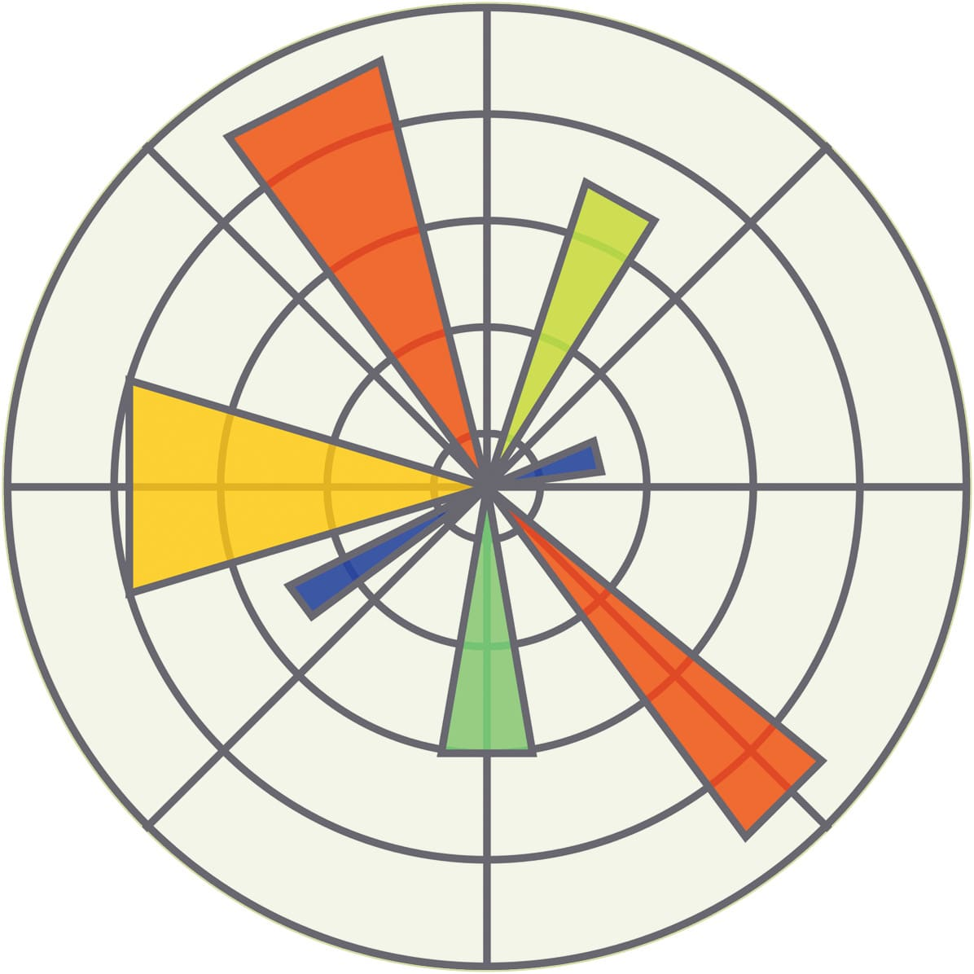
TECHNOLOGIES
NetworkX
we’ve used this to handle with the graph creation and giving them a random topology
Matplotlib
To graph our process.
Python
We’ve used python for this project
Zmq
We’ve used this library to handle socket receiving and replaying.

Slide 4
SYSTEM ARCHITECTURE
Application Graph
The project implements a distributed framework that manages communication and coordination between processes, even in the presence of Byzantine failures.
Application Process
Macro Node: Tree structure containing nodes (dictionary of dictionaries).
Node: Main process with its own events, communicates with other nodes and integrates a Replicated State Machine (RSM).
RSM: Manages replicated state, ensuring that each replica performs the same operations in the correct order.
PFD (Perfect Failure Detector): Detects malfunctioning processes (Byzantine failures), at the RSM level.
Consensus: Coordination between nodes to ensure agreement on the state.
Graph
PFD
Graph Node
RSM
PFD
CONS
PP2P Link

Slide 5
IMPLEMENTATION
APPLICATION GRAPH
(app_graph.py)
GRAPH NODE
RSM
(graph_node.py)
(RSM.py)
GRAPH
(graph_gen.py)
APPLICATION PROCESS
(app_process.py)

Slide 6
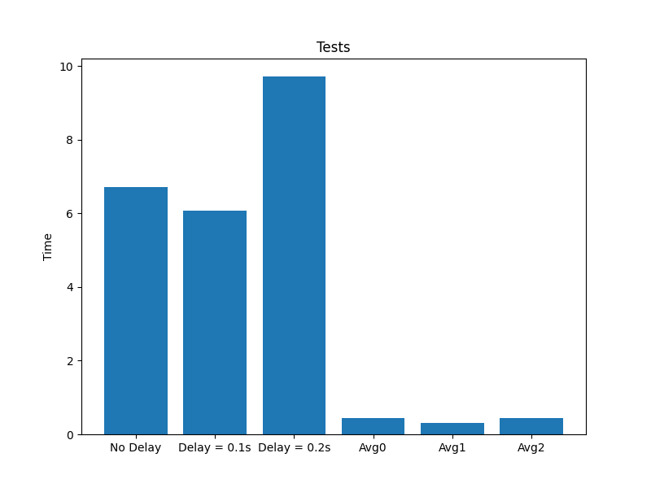
DEPENDABILITY EVALUATION
Time needed for send operations, considering:
15 send operations.
AVG(i) = (TOTAL_TIME – 15*DELAY) / 15
BEST_THROUGPUT = 2.5 Send/sec

Slide 7
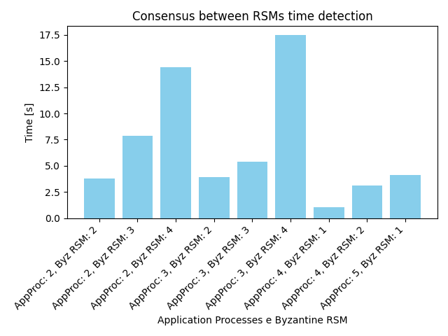
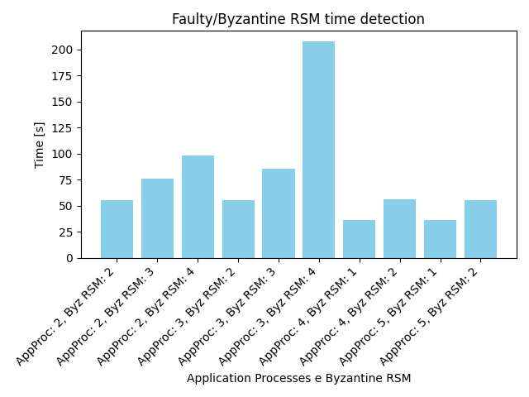
SCALABILITY EVALUATION

Slide 8


ARCHITECTURE LIMITATION
 | PROBLEM | SOLUTION
Python Problems
Stack Limitation: | Fixed stack size that limits recursive calls | Increased stack size to 2,147,483,647 (max int size)
Thread Limitation: | Poor thread optimization leads to increased CPU load | Increased thread limit to 210 to improve performance.
Ports conflicts: | Assigned port may be already in use | Different attempts to use a port
Architecture Problem
Cache issue: | Differences in cache generations between Linux and Windows

Slide 9
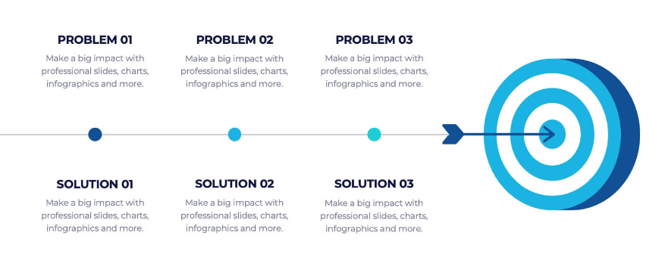
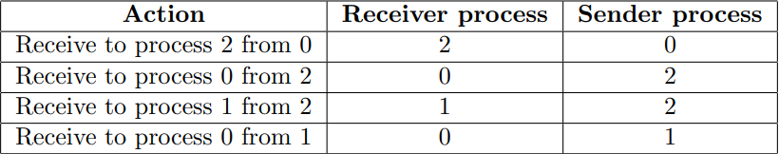
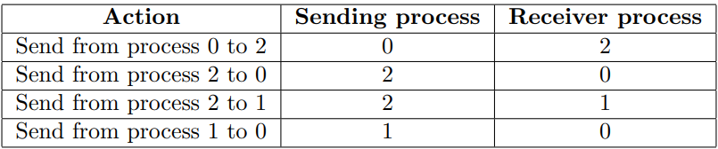
CONCLUSION
SEQUENCE OF EVENTS

Slide 10
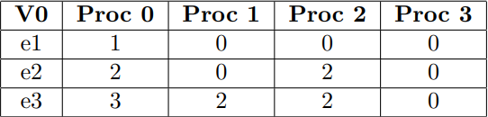
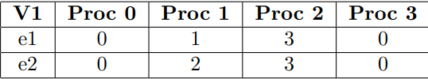
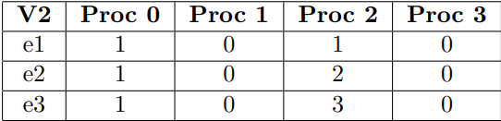
CONCLUSION
E_0^1 → E_2^1
E_1^2 → E_2^1
V_2[1, 0] = 1 >= 1
V_2[1, 1] = 0 >= 2

Slide 11
THANKS FOR YOUR ATTENTION!

